Slide 1
File Encryption
Presented by: Vaibhav Kumar Kapriyal
Section/Roll no. : A/60

Slide 2
Introduction
Threats to computer and network security increase with each passing day and come from a growing number of sources. No computer or network is immune from attack.
Encryption as provided in is a process of converting messages, information, or data into a form unreadable by anyone except the intended recipient.
The technology enables files to be transparently encrypted to protect confidential data from attackers with physical access to the computer.
Encrypted data must be deciphered, or decrypted, before it can be read by the recipient.

Slide 3
Objective
To explore and implement an encryption and digital signature program to use with the aim of providing the user with a basic knowledge of the fundamental techniques of encryption and digital signature.
To provide the user with authentication, integrity, confidentiality and non-repudiation of the data.
To provide the user with an enhanced security of their data.
To provide the user with a way to easily and conveniently protect the data.
User friendly interface.

Slide 4
Tools Used
From cryptography :
Fernet based tools:
1. generate_key ()
2. encrypt(data)
3. decrypt()
From tkinter
1.Messagebox()
2.Filedialog()

Slide 5
Methodology Used
We have used Symmetric Encryption Method.
Also called private-key cryptography or a secret key algorithm, this method requires the sender and the receiver to have access to the same key.
So, the recipient needs to have the key before the message is decrypted. This method works best for closed systems, which have less risk of a third-party intrusion.
On the positive side, symmetric encryption is faster than asymmetric encryption.
However, on the negative side, both parties need to make sure the key is stored securely and available only to the software that needs to use it.

Slide 6
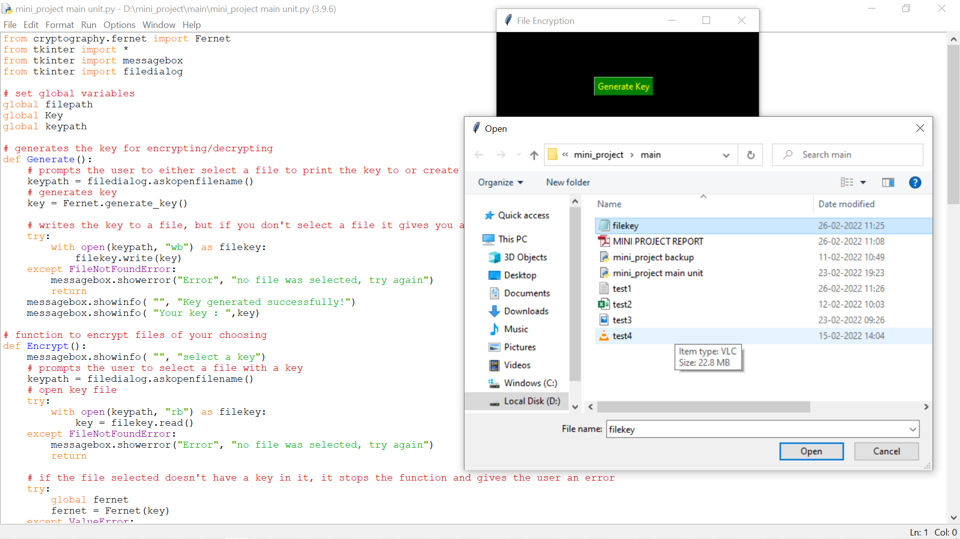
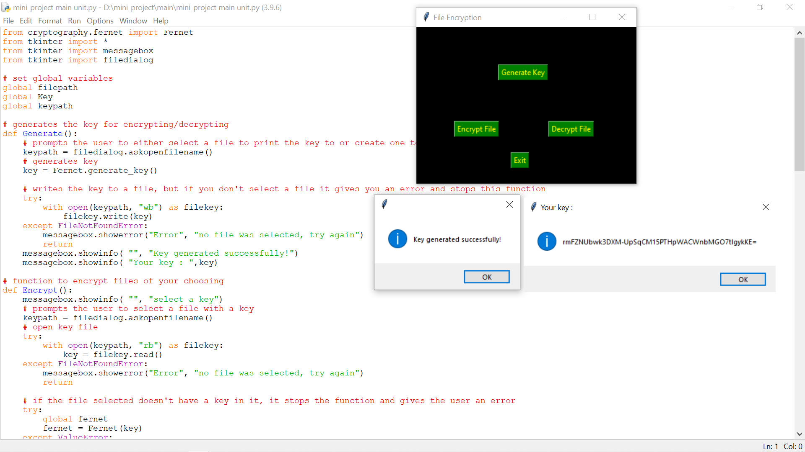
Generate Key
Using the inbuilt function in fernet module i.e. generate_key() we generate our key.
This method generates a new fernet key. The key must be kept safe as it is the most important component to decrypt the file.

Slide 7
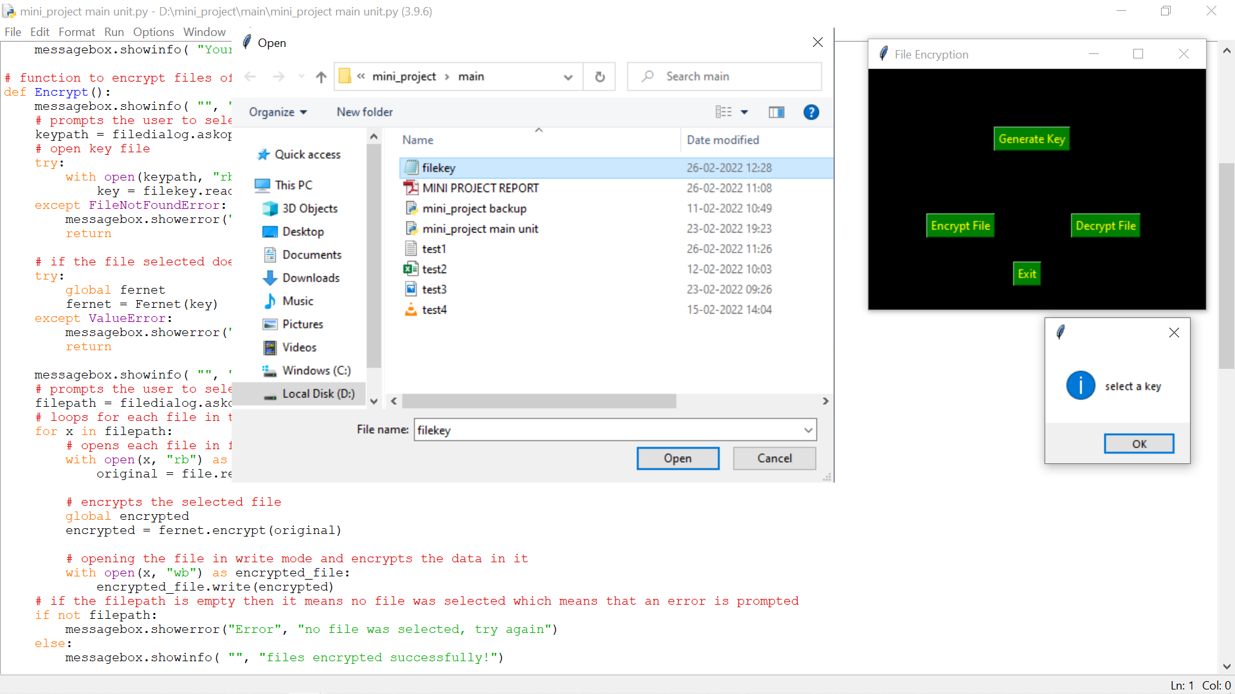
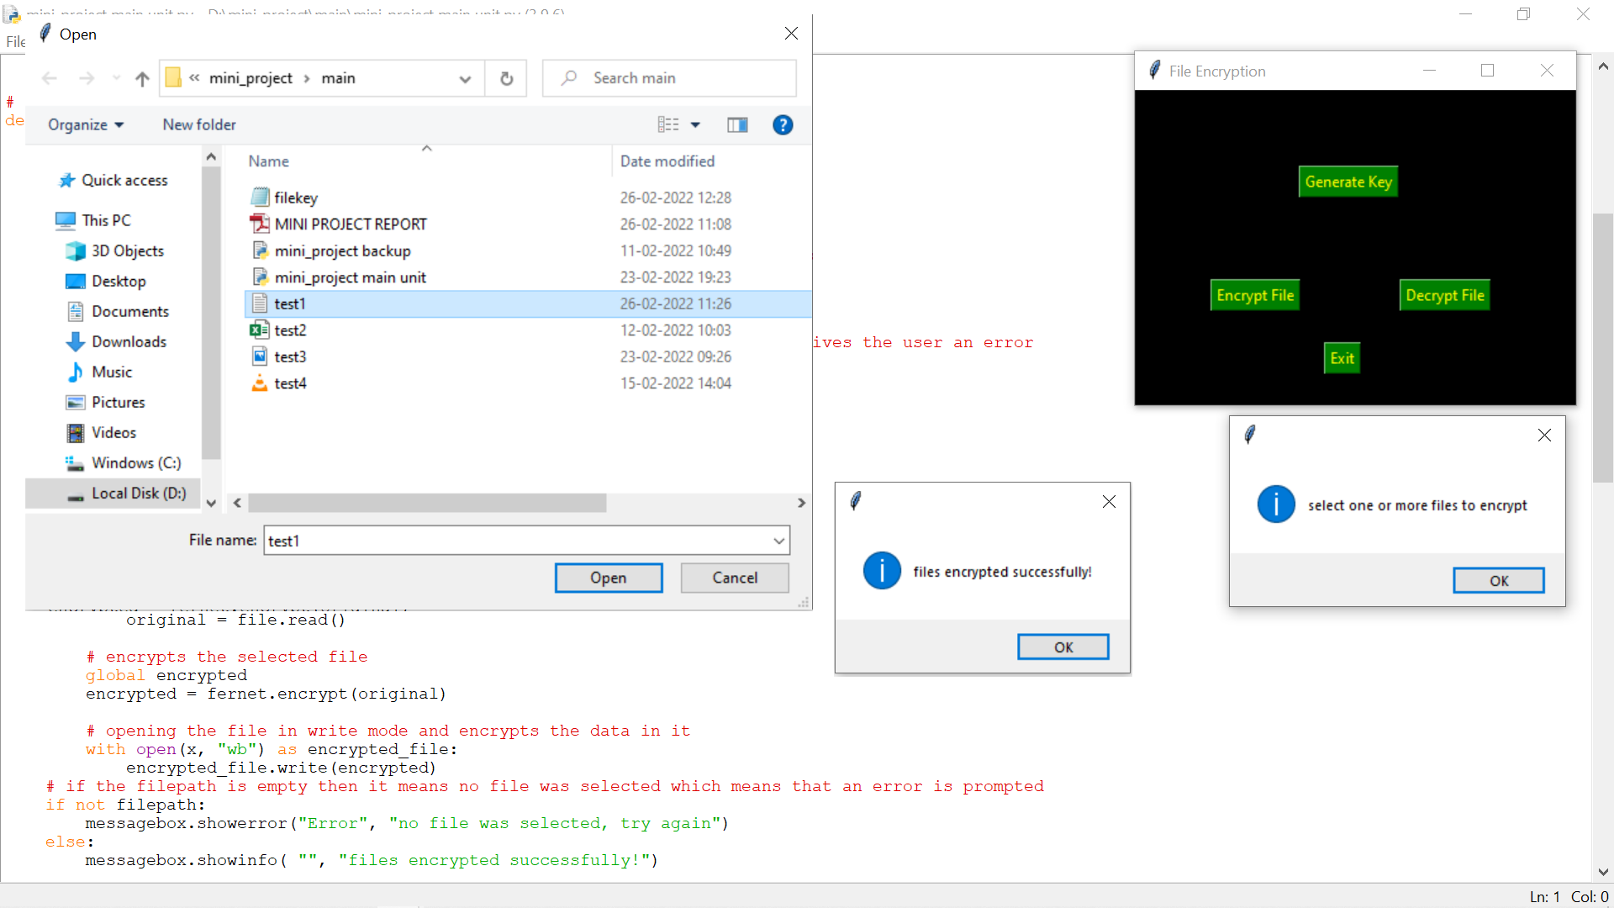
Encryption
Using the function encrypt(data),It encrypts data passed as a parameter to the method. The outcome of this encryption is known as a “Fernet token” which is basically the ciphertext based file.

Slide 8

Decryption
Using the function decrypt (token, ttl=None),This method decrypts the Fernet token passed as a parameter to the method. On successful decryption the original file is obtained as a result, otherwise an exception is thrown.

Slide 9
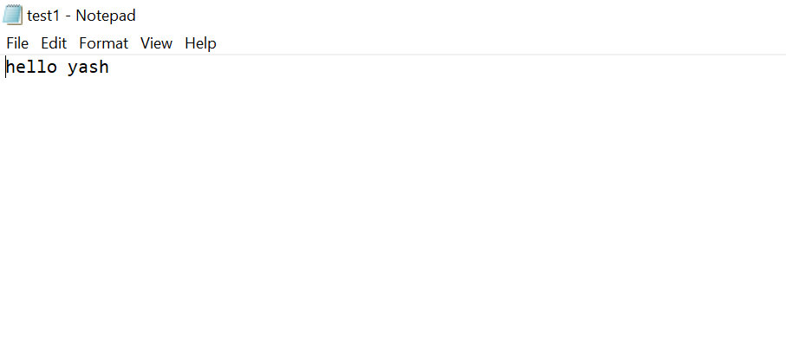
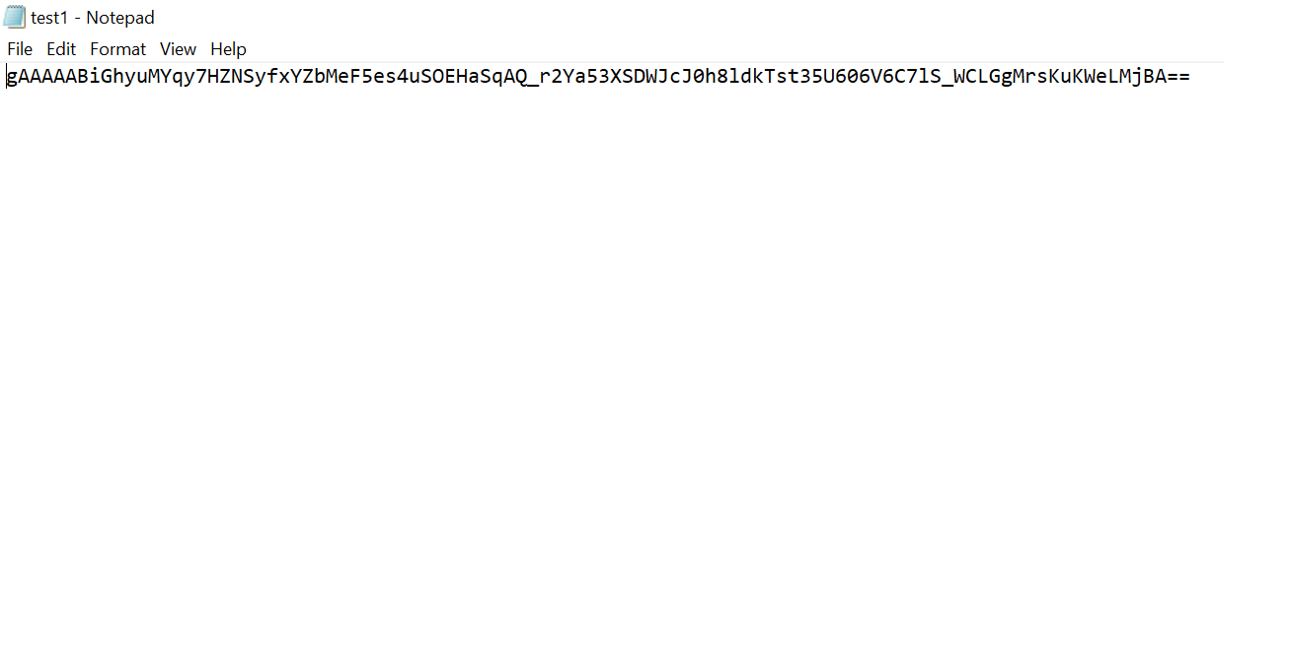
Between the process
.
.
.
Before Encryption
After Encryption
After Decryption

Slide 10
Reference
Geek for Geek
Google
YouTube
Tutorialpoint
Java point

